Slide 1
Being prepared in a sparse world : The case of KNN graph construction
Antoine Boutet
University of Lyon
antoine.boutet@liris.cnrs.fr
Anne-Marie Kermarrec
INRIA
anne-marie.kermarrec@inria.fr
Nupur Mittal
INRIA
nupur.mittal@inria.fr
Francois Taiani
University of Rennes 1
francois.taiani@irisa.fr
ICDE-2016
TianzhuWei
2016/8/20
Notes:
Antoine Boutet，法国里昂大学，图像、信息学实验室，国家科学研究中心
Anne-Marie Kermarrec (INRIA)French Institute for Research in Computer Science and Automation法国计算科学与自动化研究所
Nupur Mittal 法国国家信息与自动化研究所
Francois Taiani 雷恩第一大学

Slide 2
Contents
Preparation
Problem definition
Our solution
Experiments
Conclusion

Slide 3
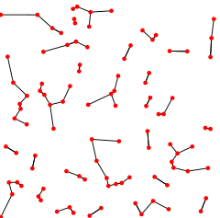
Preparation
K=1
KNN Graph (k nearest neighbor graph)
C
A
B
(e.g. Euclidean distance)
Notes:
In many discussions the directions of the edges are ignored and the NNG is defined as an ordinary (undirected) graph.
However, the nearest neighbor relation is not a symmetric one, i.e., p from the definition is not necessarily a nearest neighbor for q.
如果构建一个精确KNN图要 O(n²) 时间太长,所以我们选择构建一个 近似KNN图 （ Approximate-Nearest-Neighbor graph ）接下来我们讨论的就是如何创建一个ANN图

Slide 4
Preparation
Similarity Metric
Jaccard Coefficient
Tanimoto Coefficient
Pearson Coefficient
Euclidean Distance
Cosine
……
The ways to determine the similarity between two nodes.
Similarity = f_{sim} ( nodeA , nodeB )
f_{sim}( A , B ) > f_{sim}( A , C )
f_{sim}( B , A ) > f_{sim}( B , C )
f_{sim}( C , B ) > f_{sim}( C , A )
C
A
B
Notes:
If we can quantify different attributes of data objects, we can employ different similarity algorithms across those attributes that will yield similarity scores between the different data objects.

Slide 5
Contents
Preparation
Problem definition
Our solution
Experiments
Conclusion

Slide 6
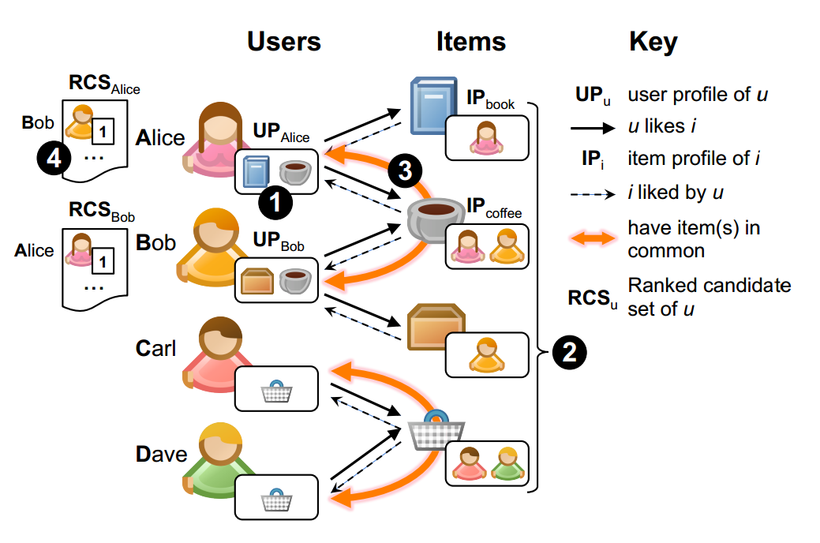
Problem definition
Our objective is to approximate a KNN graph.
ratings
item1
entity
book
item2
entity
……
coffee
Alice
ratings
f_{sim}( userA , userB )
Cosine
number of common items
Notes:
小型社交网络图
计算A和B之间的相似性由 共同爱好的个数以及相连的接的 ratings 值

Slide 7
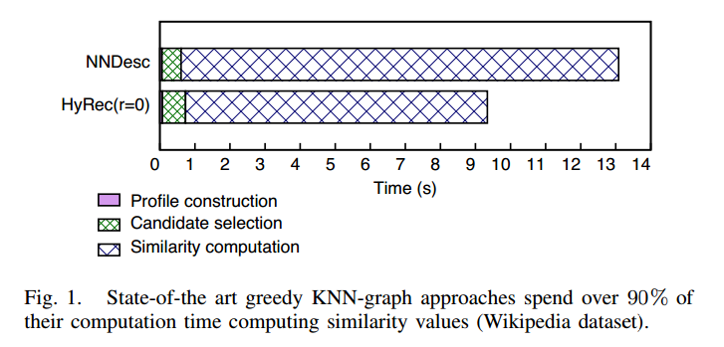
Problem definition
Reduce this substantial cost :
two nodes must usually share some items to be KNN neighbors;
the more items two nodes have in common, the more likely they are to appear in each other’s KNN neighborhood.
item
Alice
Bob
······

Slide 8
Contents
Preparation
Problem definition
Our solution
Experiments
Conclusion

Slide 9
Our solution
KIFF(K-nearest neighbor Impressively Fast and eFficient)
Counting Phase
builds a Ranked Candidate Set (RCS) for each user.
Item’s profile
IP_{book} = { Alice }
IP_{coffee} = { Alice , Bob }
User’s profile
UP_{Alice} = { book , coffee }
RCS_{Alice} = { ( Bob , 1 ) }
Notes:
使用多重集来存储 RCS
RCS are ordered weighted sets that bring together users who share items, while counting how many items these users have in common.

Slide 10
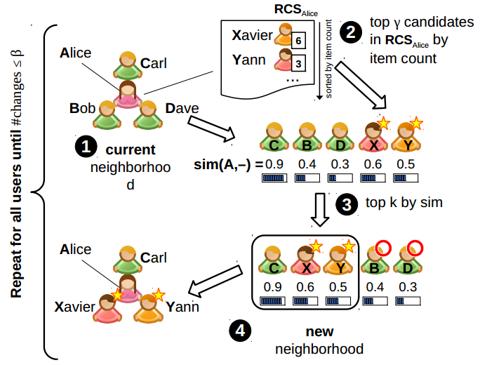




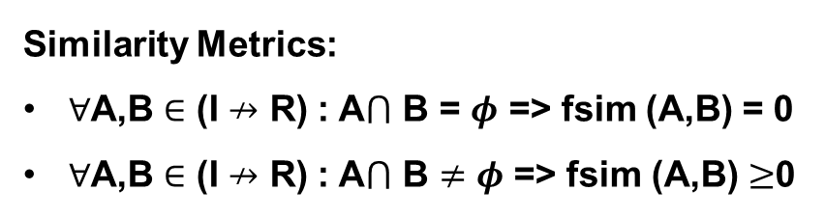

K = 3
Our solution
γ generally use 2k
Refinement Phase
RCS_{Alice} =
注意：除了第一遍时为用户赋予初值，其他遍数时不再赋值。
再注：当用户执行了取 γ 元素之后，就为下一个元素执行 取 γ 元素的操作，不是一个用户一直 γ 取到changes 改变
{(Bob,10),(Carl,9),(Dave,8) , (Xavier,6),(Yann,3),… }
$$\text{changes}$$
Xavier
Bob
Carl
Yann
Dave
Alice
Similarity Metrics:
$∀$A,B $∈$ (I $↛$ R) : A$⋂$ B = $φ$ => fsim (A,B) = 0
$∀$A,B $∈$ (I $↛$ R) : A$⋂$ B $≠φ$ => fsim (A,B) $≥$0
Bob
Carl
Dave
Xavier
Yann
Similarity
with Alice :
0.4
0.9
0.3
0.6
0.5
Notes:
任一集合任一空间
用一个最小堆（大小为 k ）来保存当前邻居

Slide 11
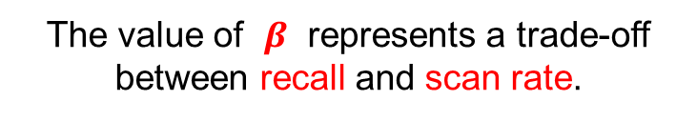
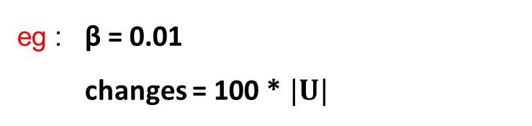
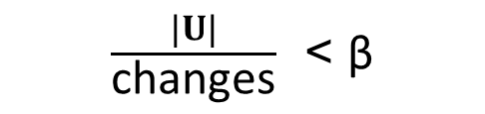
Our solution
Refinement Phase
$\frac{|U|}{\text{changes}}$ < β
eg : β = 0.01
changes = 100 * $|U|$
The value of $β$ represents a trade-off between recall and scan rate.
Notes:
$β$ 值的设定是平衡 准确率 和 scanrate 的取舍
The algorithm stops when the average number of changes per user during an iteration has dropped below a predefined threshold β.

Slide 12
Our solution
Optimization
RCS are heavily redundant ;
RCS_{Alice} = { ( Bob , 1 ) , …… }
RCS_{Bob} = { ( Alice, 1 ) , …… }
pivot strategy
Ela
Alice
Frank
Carl
Dave
Xavier
Yann
Alice
Bob
Similarity = f_{sim} ( Alice, Bob)

Slide 13
Our solution
Optimization
RCS are heavily redundant ;
simplify the initialization of neighborhoods at the start of the refinement phase ;

Slide 14
Contents
Preparation
Problem definition
Our solution
Experiments
Conclusion

Slide 15
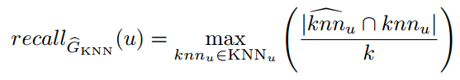

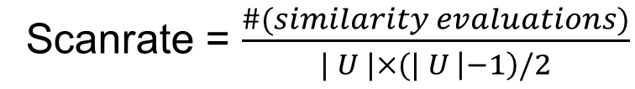
Experiments
Recall : The quality of this approximation
Scanrate = $\frac{\#(similarity evaluations)}{| U |×(| U \left|−1\right)/2}$

Slide 16
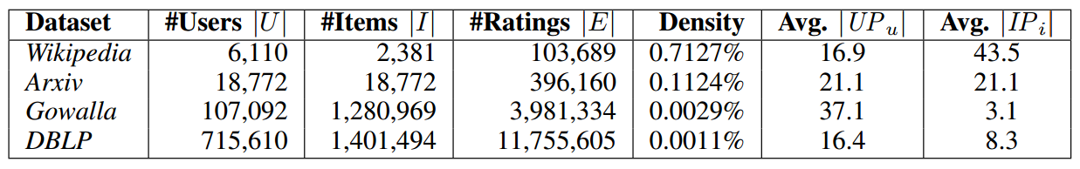

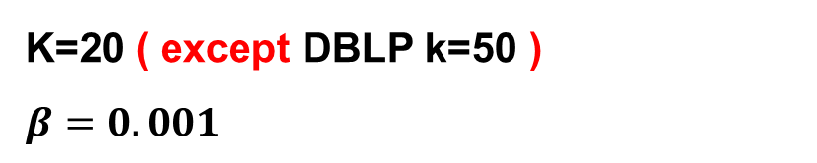
Experiments
DATASET DESCRIPTION
density = | E | $÷$( | U |$×$| I | )
K=20 ( except DBLP k=50 )
$$β=0.001$$
Notes:
ratings : number of ratings (i.e., the number of weighted edges in the user-item bipartite graph)
完全有向图

Slide 17
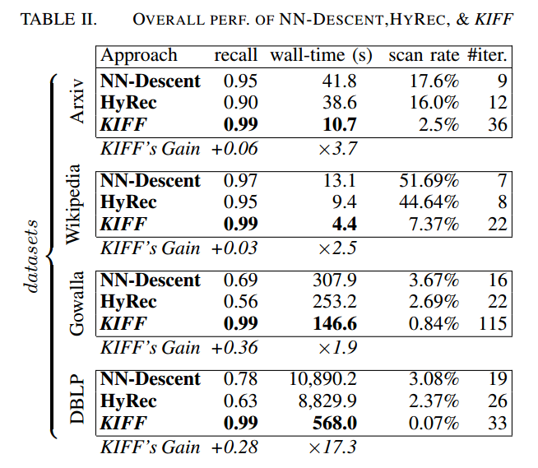
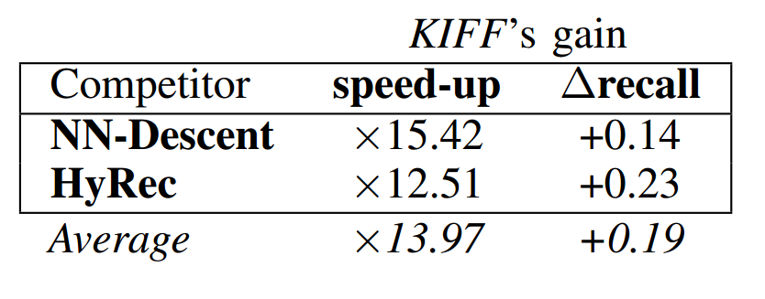
Experiments
Notes:
图二表示
第一行： 比NN方法快15.42倍
第二行： 比HyRec方法快12.51倍
第三行： 比两个个对比方法平均快13.97倍

Slide 18
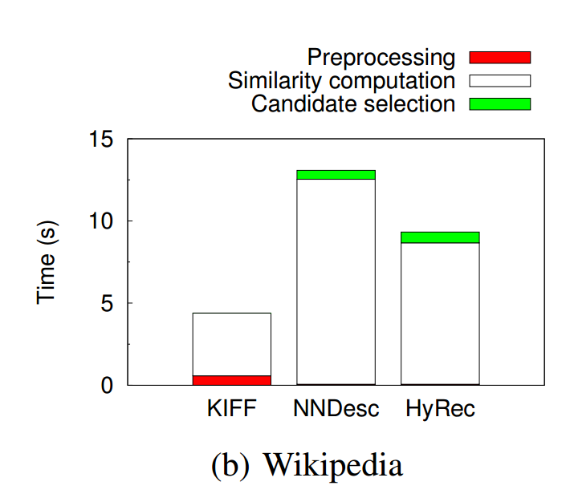
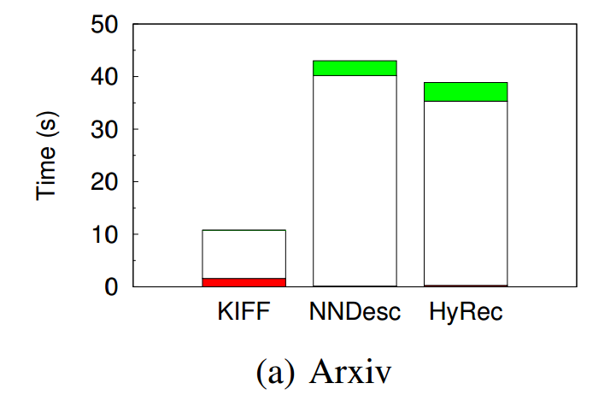
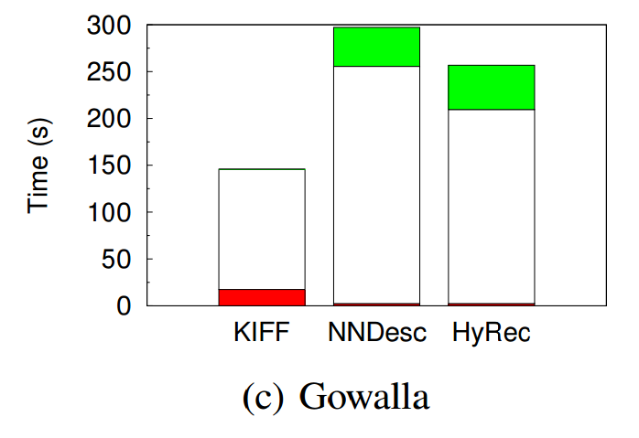
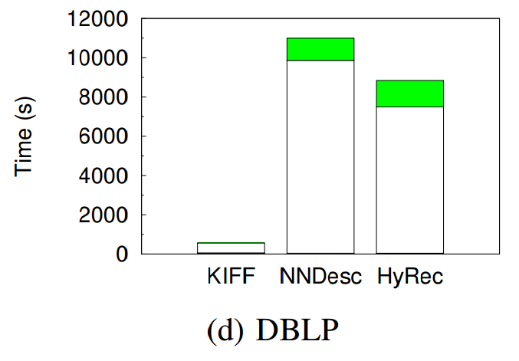
Experiments
Notes:
Preprocessing 计算求解出RCS之前的所用时间
Candidate selection 利用RCS 求得当前的邻居
Sililarity computation 计算两个用户（所有）之间的相似度所用时间

Slide 19
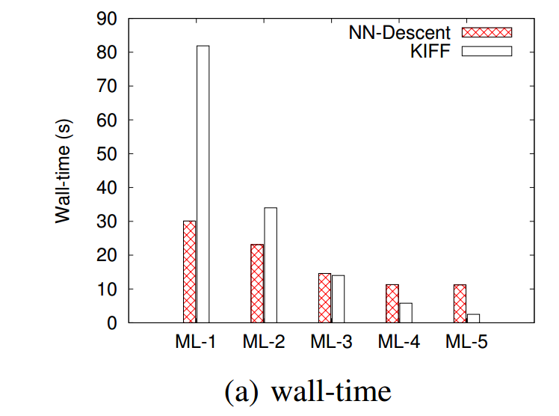
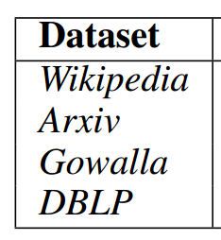
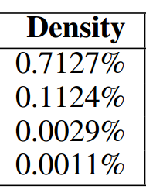
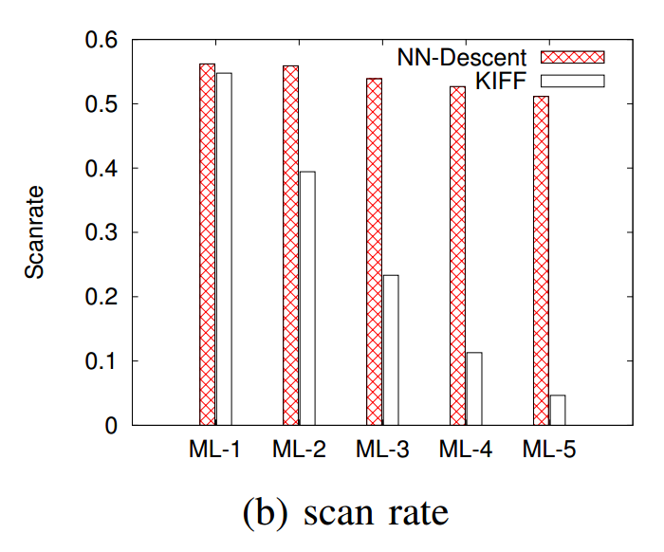
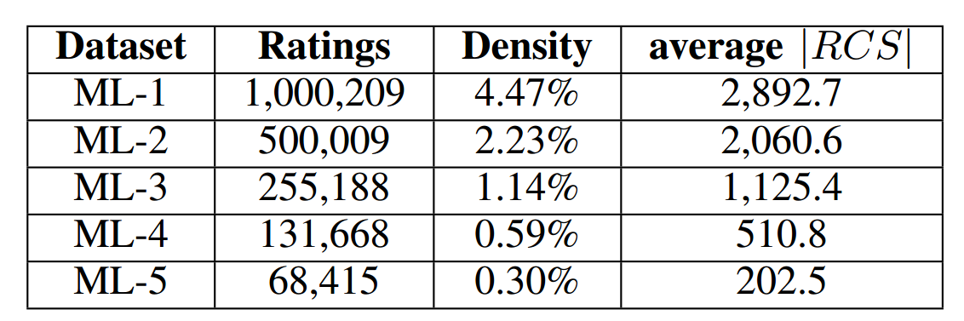
Experiments
Impact of density
low density for KIFF to perform well !

Slide 20
Contents
Preparation
Problem definition
Our solution
Experiments
Conclusion

Slide 21
Replace the old method :
If A is similar to B ,and B to C,
then A is likely to be similar to C.
Conclusion
KNN neighbors must share some items
Use the node-item bipartite graph to compute RCS
the more items two nodes have in common, the more likely they are to appear in each other’s KNN neighborhood.
Being prepared in a sparse world
Experimental
Improve the rate of right neighbors
Reduce the cost of Similarity computation

Slide 22
Thanks

Slide 23
